Slide 1
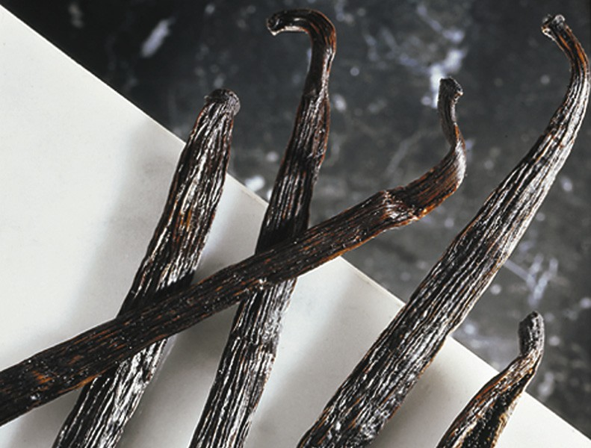
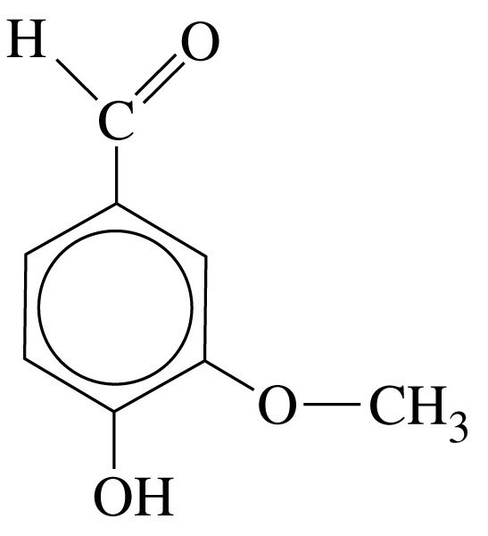
Chapter 27: Organic Chemistry
General Chemistry
Principles and Modern Applications
Petrucci • Harwood • Herring
8th Edition
Philip Dutton
University of Windsor, Canada
N9B 3P4
Prentice-Hall © 2002

Slide 2
Contents
27-1 Organic Compounds and Structures: An Overview
27-2 Alkanes
27-3 Alkenes and Alkynes
27-4 Aromatic Hydrocarbons
27-5 Alcohols, Phenols, and Ethers
27-6 Aldehydes and Ketones
27-7 Carboxylic Acids and Their Derivatives
27-8 Amines
27-9 Heterocyclic Compounds

Slide 3
Contents
27-10 Nomenclature of Stereoisomers in Organic Compounds
27-11 An Introduction to Substitution Reactions at
sp³ Hybridized Carbon Atoms
27-12 Synthesis of Organic Compounds
27-13 Polymerization Reactions
Focus On Natural and Synthetic Dyes

Slide 4
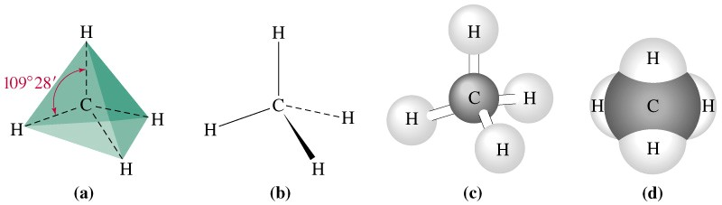
27-1 Organic Compounds and Structures: An Overview
Hydrocarbons – the simplest organic compounds.
Simplest hydrocarbon is methane.

Slide 5
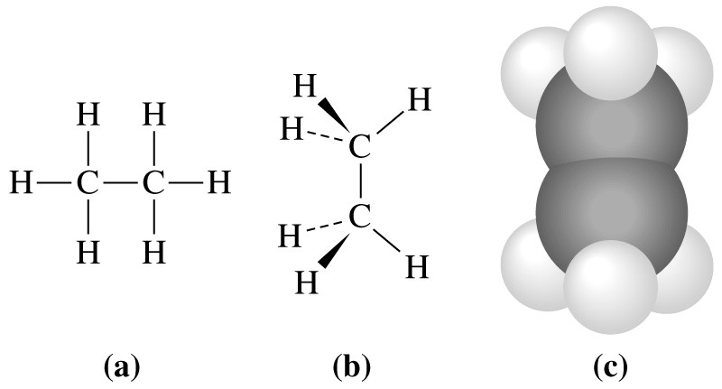
Ethane

Slide 6
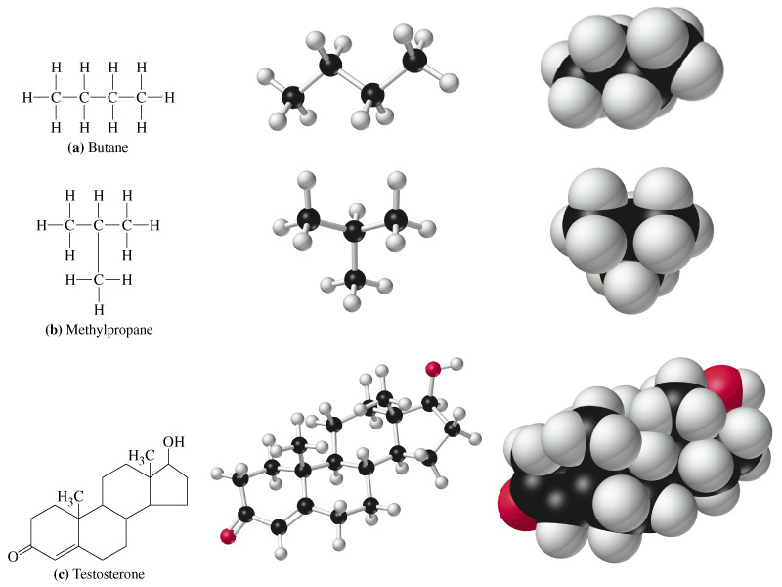
Skeletal Isomerism
Prentice Hall © 2002 General Chemistry: Chapter 27 Slide 5 of

Slide 7
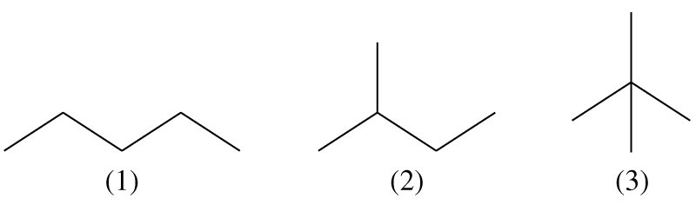
Simplified Drawings of Organic Structures

Slide 8
Nomenclature
Select the longest continuous carbon chain.
  This determines the base name.
Consider each branch and name similarly except change the name from –ane to –yl.
Number the C atoms so that substituents have the lowest possible number.

Slide 9
Nomenclature
Name each substituent according to its identity and the number of the C atom to which it is attached.
  Use di, tri, tetra as appropriate.
Separate numbers from one another by commas.
List substituents alphabetically by name.

Slide 10
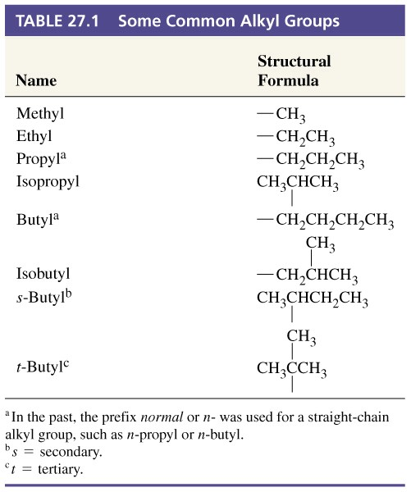
Table 27.1. Some Common Alkyl Groups

Slide 11
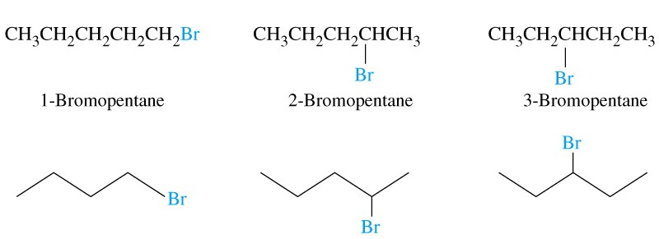
Positional Isomerism

Slide 12
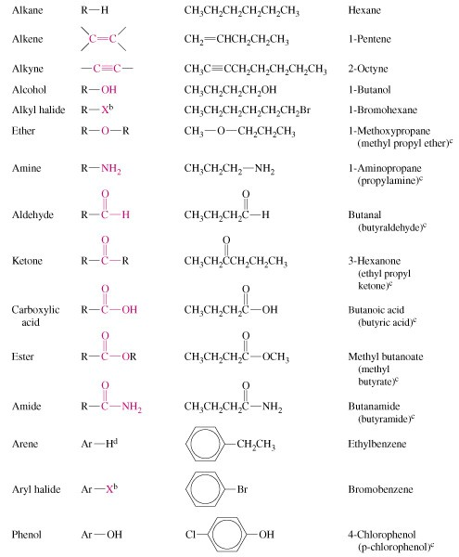
Functional Groups

Slide 13
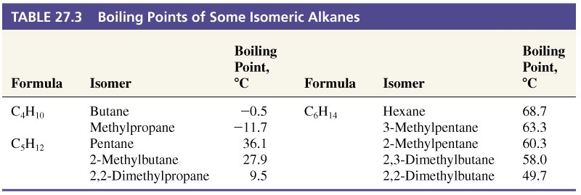
27-2 Alkanes

Slide 14
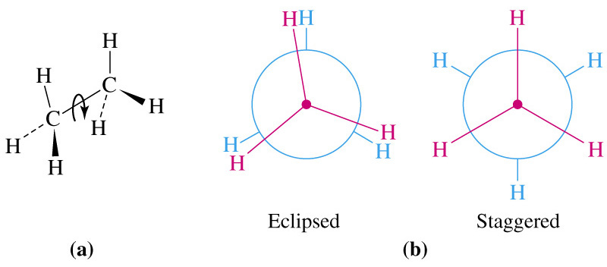
Conformations

Slide 15
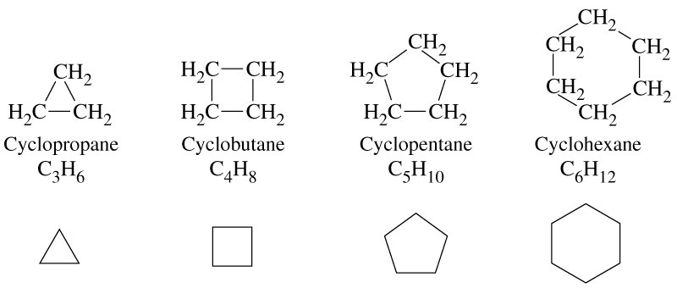
Ring Structures

Slide 16
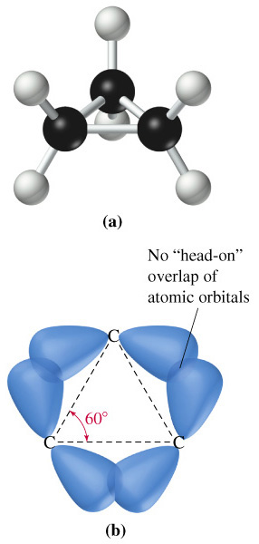
Ring Strain

Slide 17
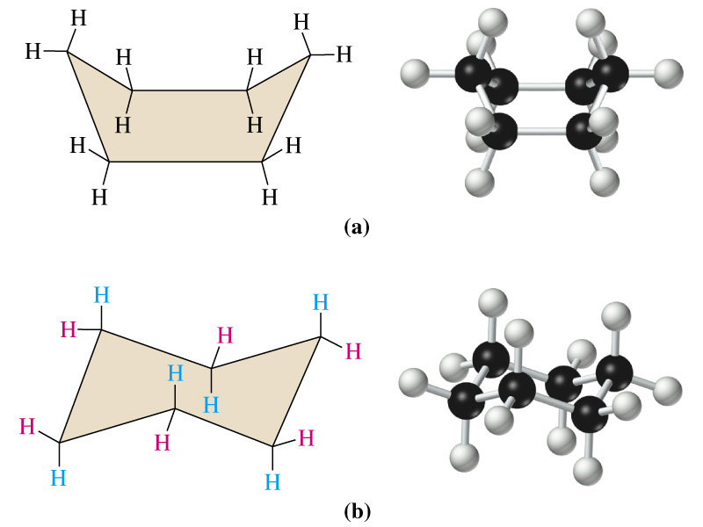
Cyclohexane Conformations

Slide 18
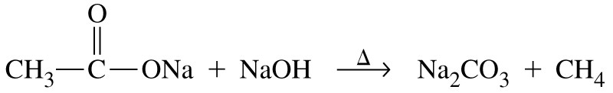
Preparation of Alkanes
Pt
Δ
CH₂=CH₂ + H₂ → CH₃-CH₃
pressure
Δ
2 CH₃CH₂Br + 2 Na → CH₃CH₂CH₂CH₃ + 2 NaBr

Slide 19
Reactions of Alkanes
Initiation:
Δ or hν
Cl-Cl → 2 Cl·
Propagation:
H₃C-H + Cl· → H₃C· + HCl
H₃C· + Cl₂ → H₃C-Cl + Cl·
Termination:
Cl· + Cl· → Cl-Cl
H₃C· + Cl· → H₃C-Cl
H₃C· + H₃C· → H₃C-CH₃

Slide 20
Combustion Reactions
25
C₈H₁₈(l) + O₂(g) → 8 CO₂(g) + 9 H₂O(l)
2
ΔH° = -5.4810³ J

Slide 21
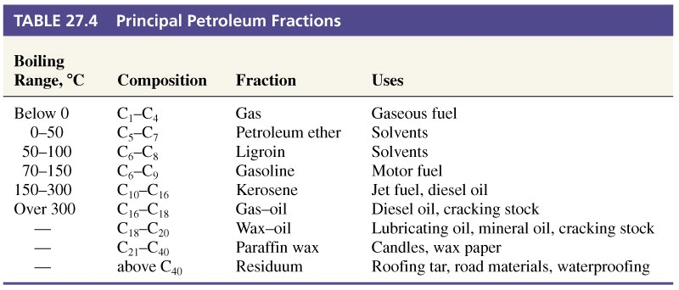
Table 27.4 Principle Petroleum Fractions

Slide 22
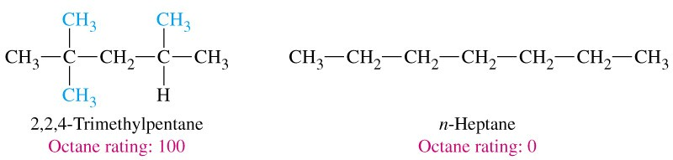
Octane Number

Slide 23
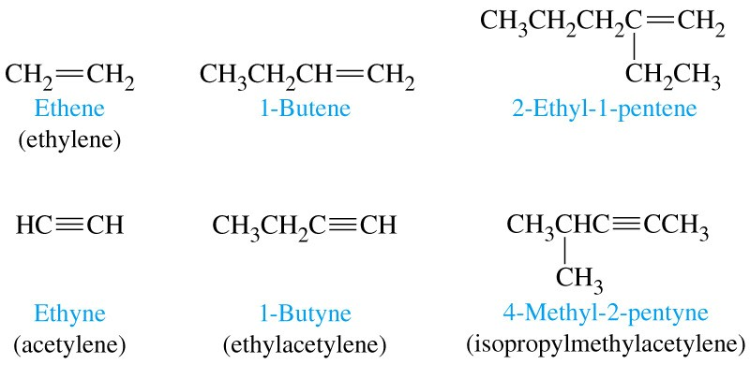
27-3 Alkenes and Alkynes

Slide 24
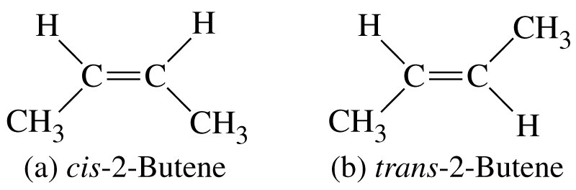
Geometric Isomerism

Slide 25
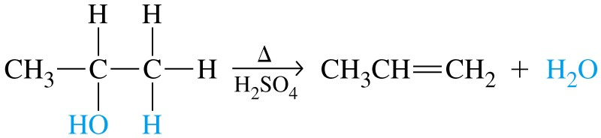
Elimination Reaction

Slide 26
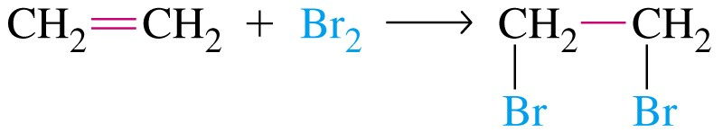

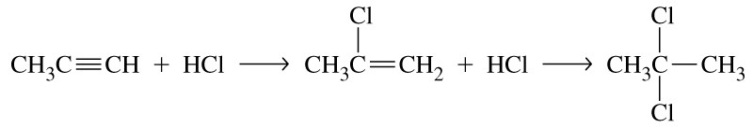
Addition Reactions
Markovnikov rule

Slide 27
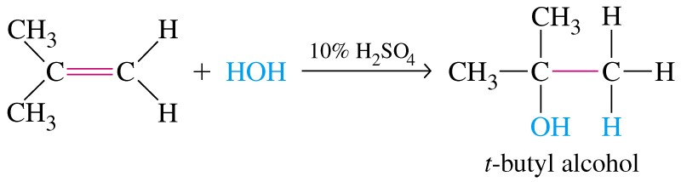
Hydration Reaction
Addition is favored in dilute acid and elimination is favored in strong.

Slide 28
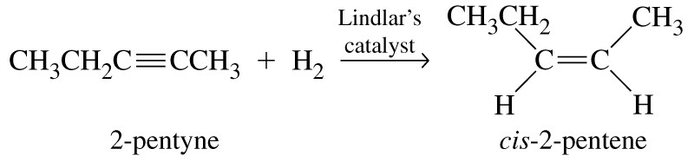
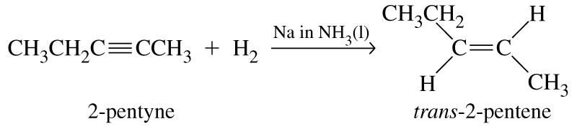
Reduction of C=C

Slide 29
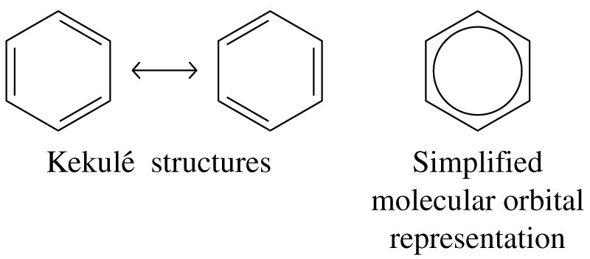
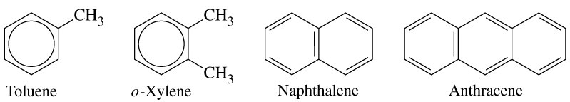
27-4 Aromatic Hydrocarbons

Slide 30
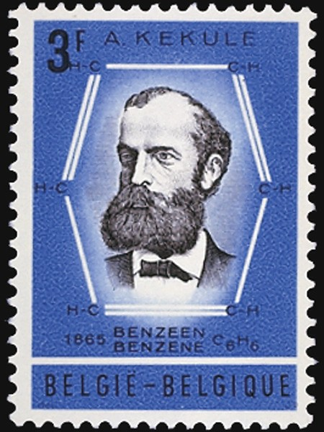
Characteristics of Aromatic Hydrocarbons
Planar (flat) cyclic molecules.
Conjugated п systems (4n + 2)

Slide 31
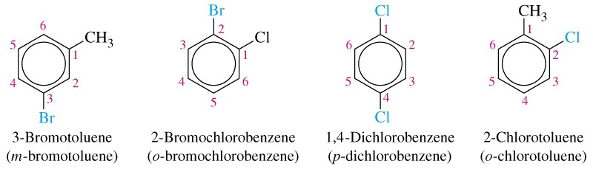
Naming Aromatic Hydrocarbons

Slide 32
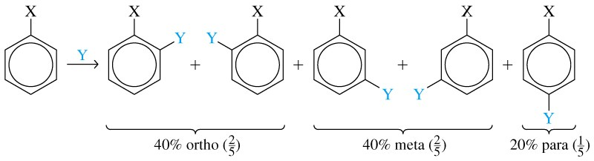
Aromatic Substitution Reactions

Slide 33
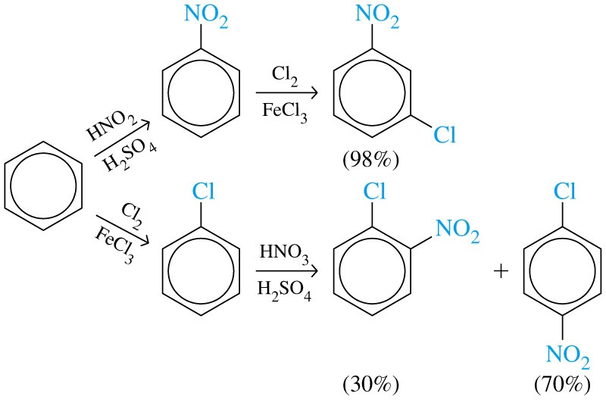
Aromatic Subsitution Reactions

Slide 34
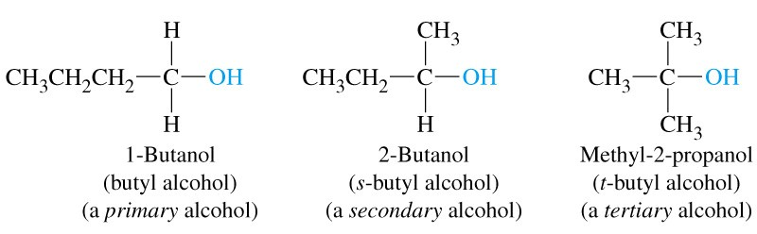
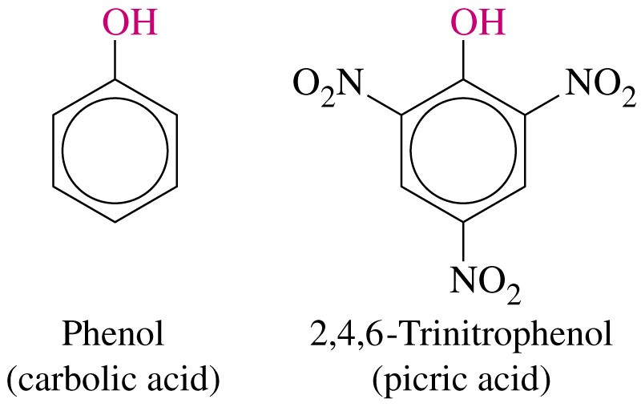
27-5 Alcohols, Phenols, and Ethers

Slide 35
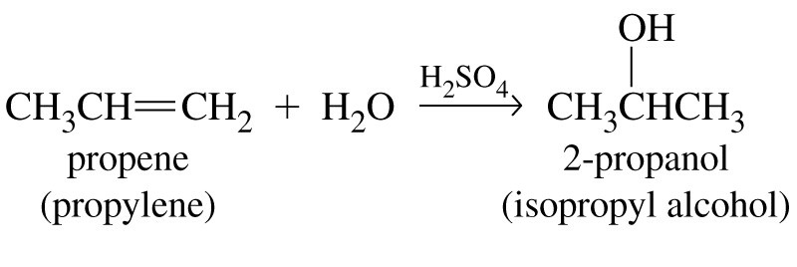
Preparation and Use of Alcohols
CO(g) + 2 H₂(g) → CH₃OH(g)
350 °C
200 atm
ZnO, Cr₂O₃

Slide 36
Preparation and Use of Alcohols
Methanol.
  21st amongst industrial chemicals.
Ethanol.
  fermentation or by hydration of ethylene.
Ehylene glycol.
  High boiling point, soluble in water.
Glycerin.

Slide 37
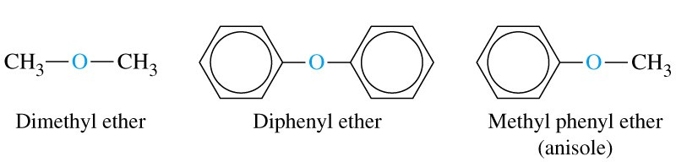
Ethers

Slide 38
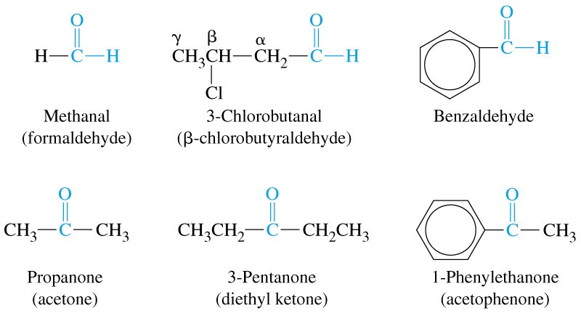
Aldehydes and Ketones

Slide 39
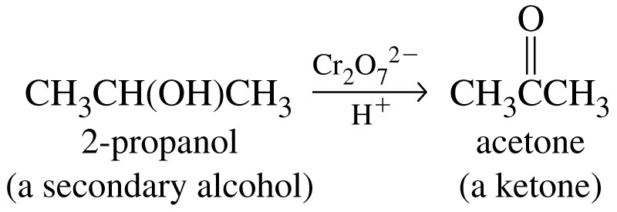
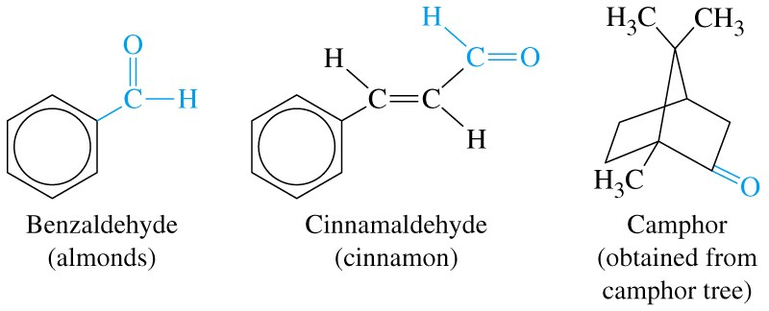
Preparation and Use
Oxidation of alcohols.
Extract from natural sources
Acetone is extensively used as a solvent.

Slide 40

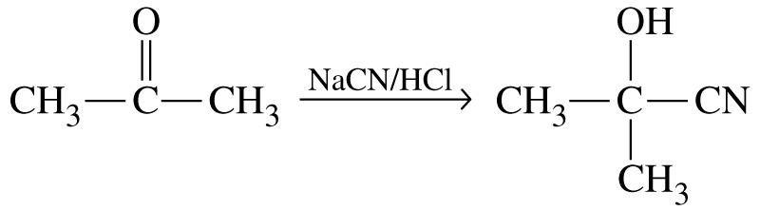
Addition Reactions of the Carbonyl Group

Slide 41
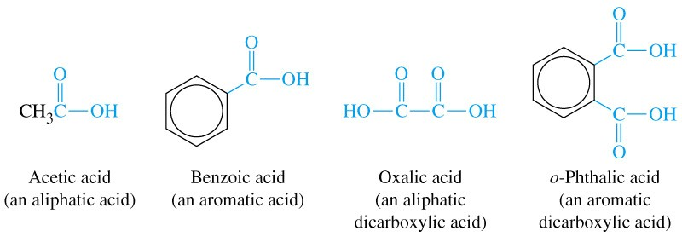
27-7 Carboxylic Acids and Their Derivatives

Slide 42
Oxidation of Alcohols
OH⁻
H⁺
CH₃CH₂OH + KMnO₄ → CH₃CO₂⁻K⁺ → CH₃CO₂H

Slide 43
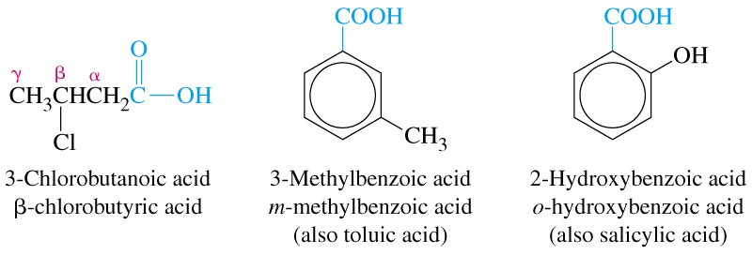
Aromatic Acids

Slide 44
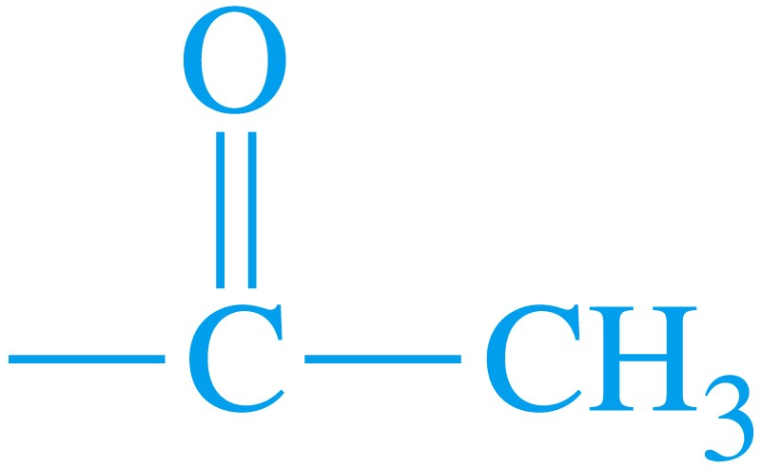
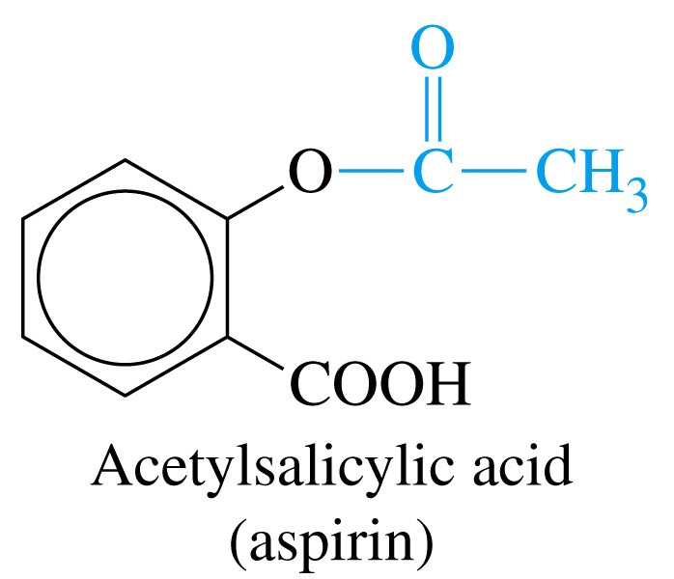
Acetyl Group

Slide 45
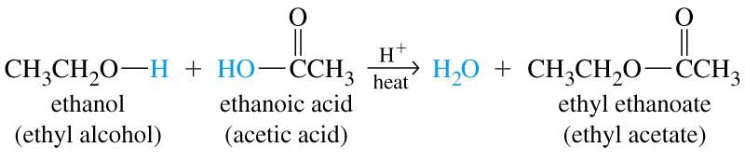
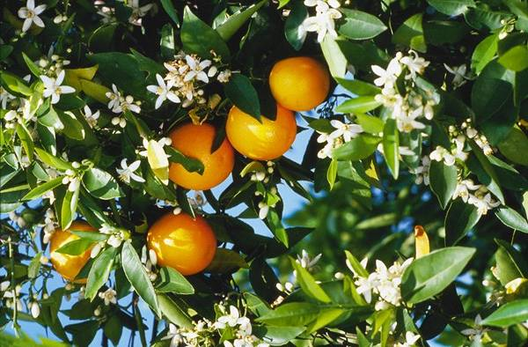
Esters

Slide 46
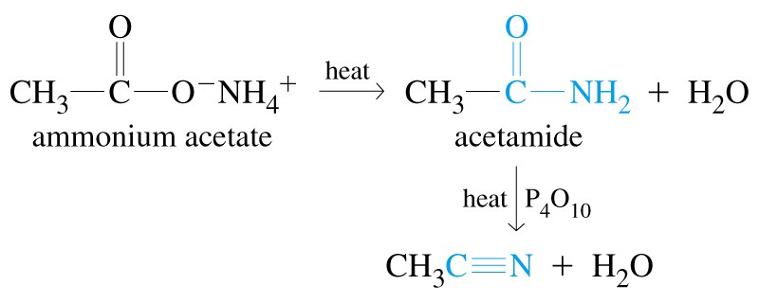
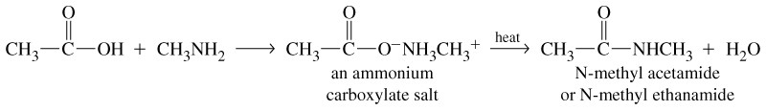
Amides

Slide 47
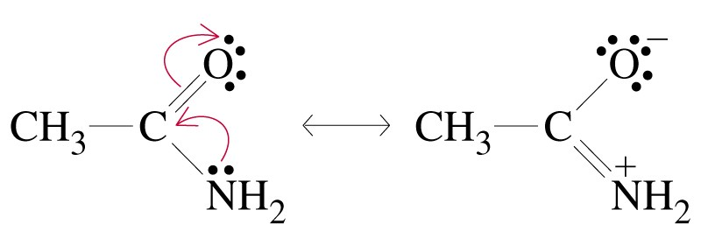
Resonance in Amides

Slide 48
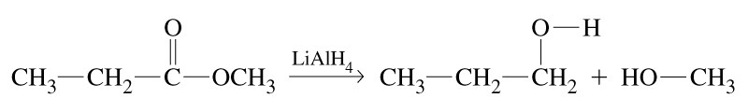
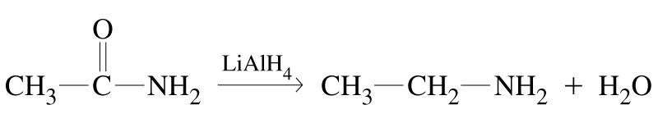
Reduction Reactions

Slide 49

Amines

Slide 50

Preparation of Amines
2 NH₃ + CH₃Br → CH₃NH₃⁺Br⁻ + NH₃ → CH₃NH₂ + NH₄Br

Slide 51

Basicity of Amines

Slide 52

Ammonium Salts

Slide 53

27-9 Heterocyclic Compounds

Slide 54

27-10 Nomenclature of Stereoisomers in Organic Compounds

Slide 55

Chirality

Slide 56

The R,S System of Nomenclature
Substituent of higher atomic number takes
precedence over one of lower atomic number:

Slide 57


The R,S System of Nomenclature
If two substituents attached to the stereocenter have the same
priority, proceed along the chains to the first point of difference:

Slide 58

The R,S System of Nomenclature
Double and triple bonds count as if they were single and the atoms are duplicated or triplicated at the other end of the
double or triple bond:

Slide 59


The E,Z System of Nomenclature

Slide 60

The E,Z System of Nomenclature

Slide 61

27-11 An Introduction to Substitution Reactions at sp³ Hybridized Carbon

Slide 62


S_{N}2 Mechanism
Rate = k[OH⁻][CH₃Cl]

Slide 63

Inversion of Configuration

Slide 64



S_{N}1 Mechanism

Slide 65

S_{N}1 Mechanism
Rate = k [(CH₃)₃CCl]

Slide 66

Racemic Products From S_{N}1 Reactions

Slide 67

27-12 Synthesis of Organic Compounds

Slide 68

27-13 Polymerization Reactions

Slide 69

Table 27.5 Some Polymers Produced by Chain-Reaction Polymerization

Slide 70

Condensation Polymerization

Slide 71

Table 27.6 Some Polymers Produced by Step Reaction Polymerization

Slide 72

Stereospecific Polymers

Slide 73

Focus On Natural and Synthetic Dyes

Slide 74



Focus On Natural and Synthetic Dyes

Slide 75
Chapter 27 Questions
Develop problem solving skills and base your strategy not on solutions to specific problems but on understanding.
Choose a variety of problems from the text as examples.
Practice good techniques and get coaching from people who have been here before.

